Slide 1
Minimum Spanning Tree Prim’s Algorithm
16 May. 2025

Slide 2
Prim’s Algorithm
Does not use Union Find.
Graph expanded from a random node, lets say 0.
Uses Priority Queue to take greedily the smallest edge.

Slide 3
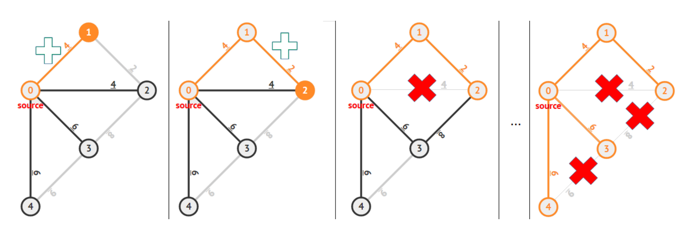
Prim’s Algorithm Visualization – I

Slide 4
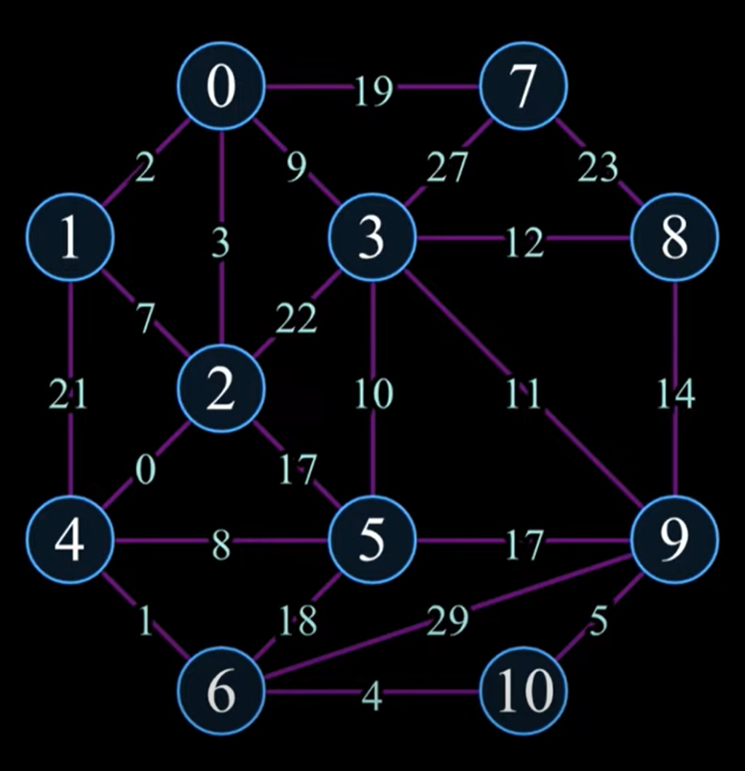
Prim’s Algorithm Visualization – II
Link to YouTube visualization.

Slide 5
Prim’s Algorithm
READ graph nodes (V) and edges (E).
CREATE PRIORITY QUEUE (PQ) with weights and IDs.
CREATE VECTOR to track taken nodes to MST (Visited)
Process(0)
MinCost: INT = 0
WHILE NOT PQ.empty():
Weight, ID = PQ.pop()
IF !Visited[ID]
Process(ID)
MinCost += Edge.Cost
PRINT MinCost
Process(ID: INT):
Visited[ID] = True
FOR Neighbor IN Graph[ID]:
IF NOT Visited[Neighbor.ID]:
PQ.push(Neighbor)

Slide 6

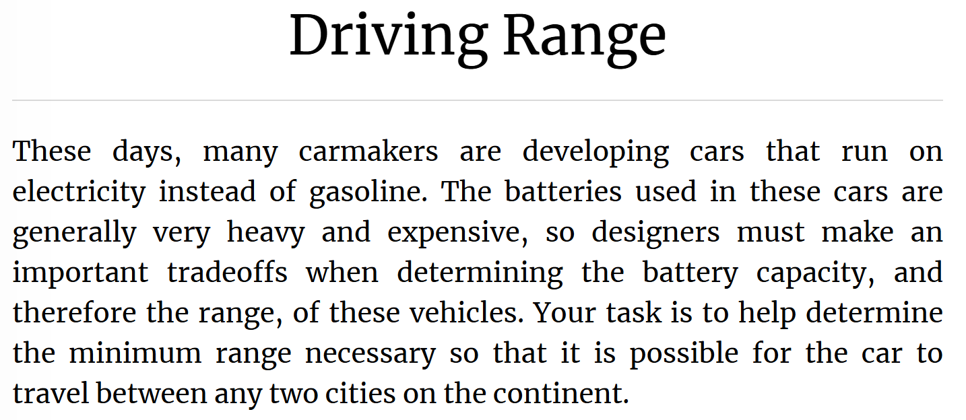
Prime’s Algorithm. Driving Range
Kattis. Driving Range – Link

Slide 7
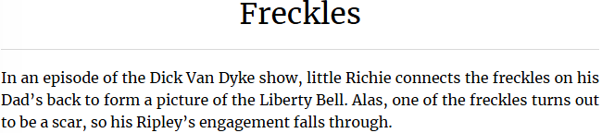
Prime’s Algorithm. Freckles
Kattis. Freckles – Link

Slide 8

Memory Optimization
Memory Consumption Problem.
Task. Kattis – Svemir.
Prime’s Algorithm
Kruskal’s Algorithm

Slide 9
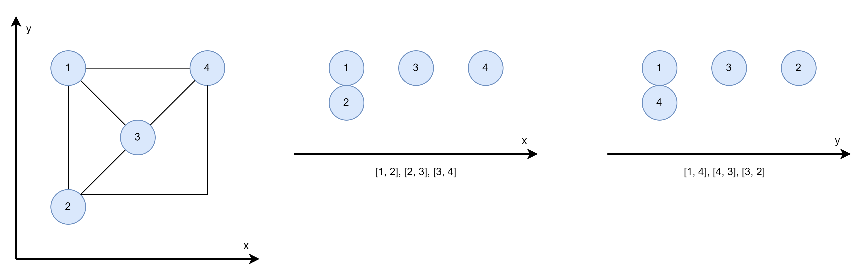
Memory Optimization
Memory Consumption Problem.
Task. Kattis – Svemir.

